Slide 1
Airline Passenger Satisfaction
2440009654 - Darnell Kikoo
2440009162 - Matthew Adrianus Mulyono
2440076450 - Winson Allan Wijaya

Slide 2

Table of Contents
03
Problem Definition
12
Data Preprocessing
Why did we do this?
Preparing the data for the model
04
Data Preparation
16
Modeling & Evaluation
The chosen dataset, and how we prepared it.
Creating the model
05
EDA
22
Results
…stands for Exploratory Data Analysis
…with the discussion

Slide 3



Problem Definition
COVID-19
Living Standards
Due to the rampant pandemic, the airline industry experienced plummeting profits.
However, living standards have in turn, improved as people took care of themselves more
Demand
These two factors results in airline industries desiring to improve their services.

Slide 4

Data Preparation
Remove Outliers
Dataset:
Airline Passenger Satisfaction by TJ Klein*
We remove columns that we deem as unnecessary
Handle Missing Values
The categorical ones are replaced with its mode, while numericals are replaced with its mean.
Data Conversion
We convert categorical data to numerical and vice versa.
*https://www.kaggle.com/datasets/teejmahal20/airline-passenger-satisfaction

Slide 5



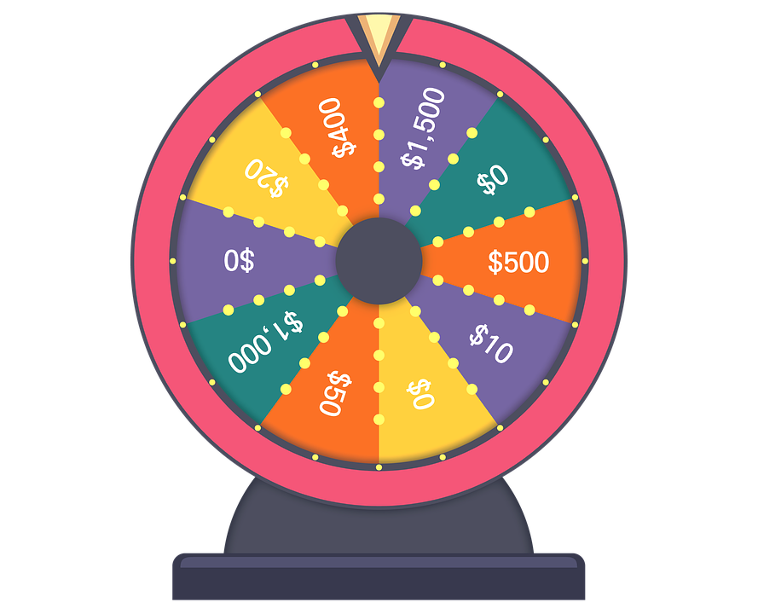

Exploratory Data Analysis
Airline Passenger Dataset
Categorical
Data
Numerical
Data
Ratings
Non-ratings

Slide 6
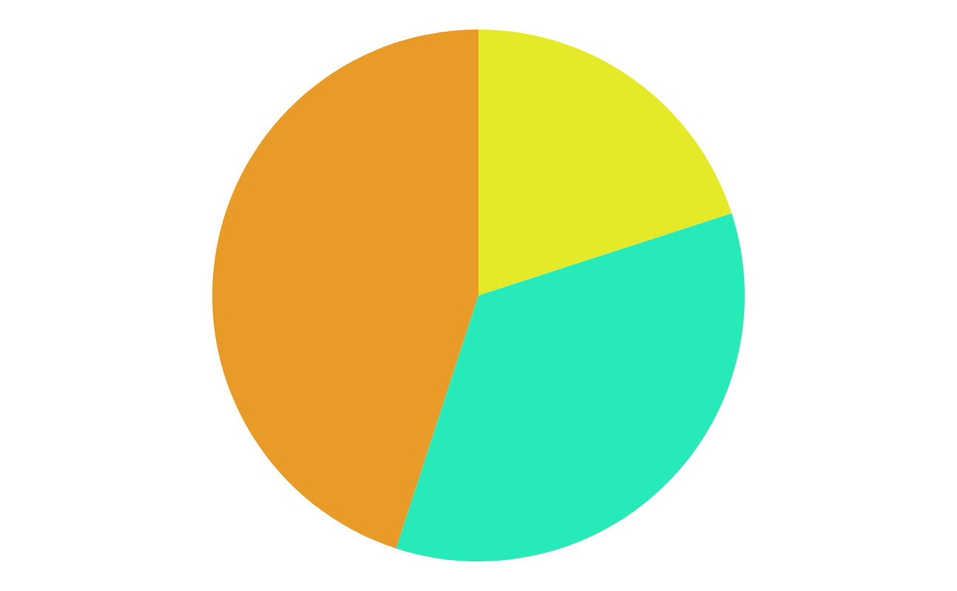
Exploratory Data Analysis
1.
3.
Categorical Label Distribution
Heatmap
The heatmap is used to find correlations between the categorical rating labels
We find out the label distribution in both the ratings and non ratings categorical labels using bar graphs
2.
Numerical Label Distribution
This is done using kdeplot and boxplot
Check out the results @ https://colab.research.google.com/drive/1ozDpPvwTh44hDEafooDxac9SjwNuupHl#scrollTo=_qPqw3_BLsrS

Slide 7
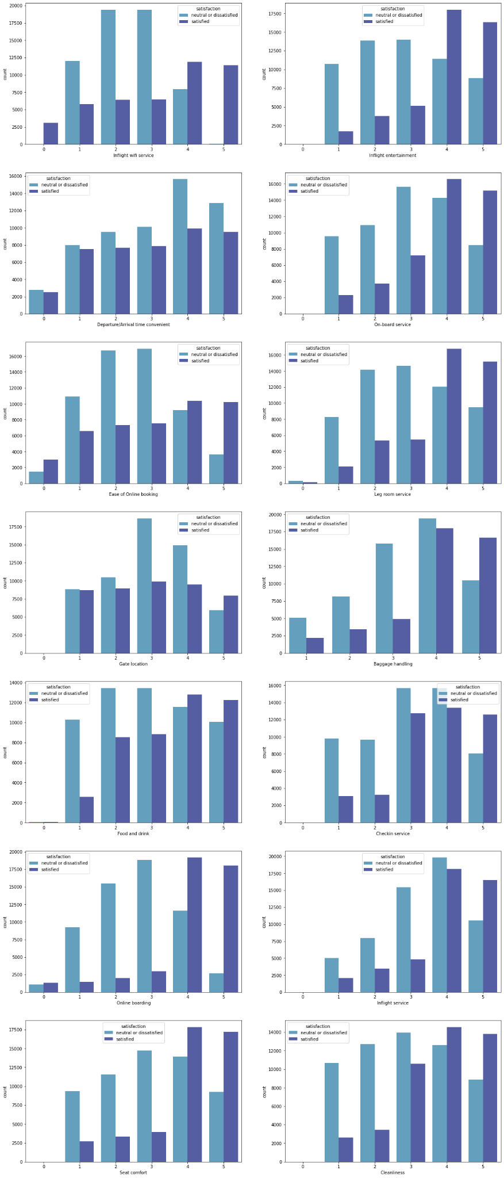
CATEGORICAL LABEL DISTRIBUTION (RATINGS)

Slide 8
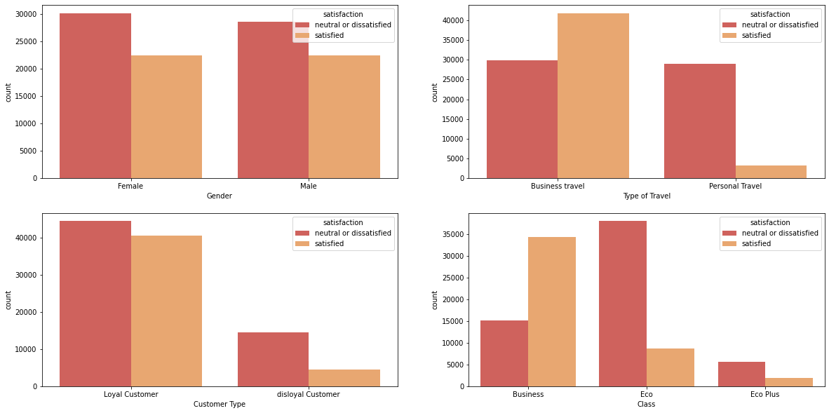
CATEGORICAL LABEL DISTRIBUTION (NON-RATINGS)

Slide 9
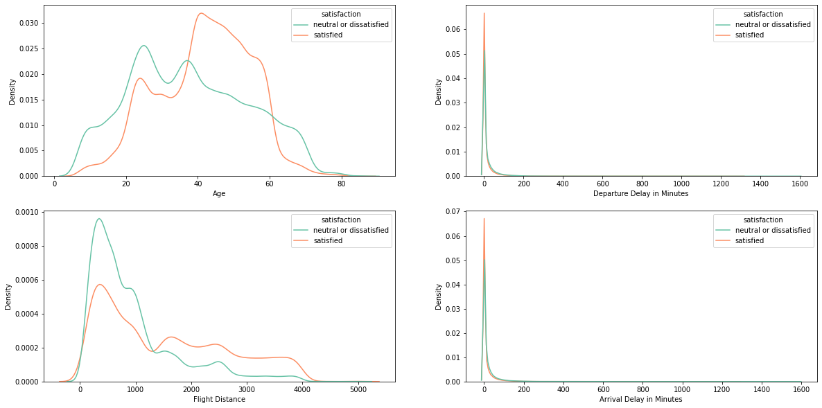
Numerical Label Distribution (Kdeplot)

Slide 10
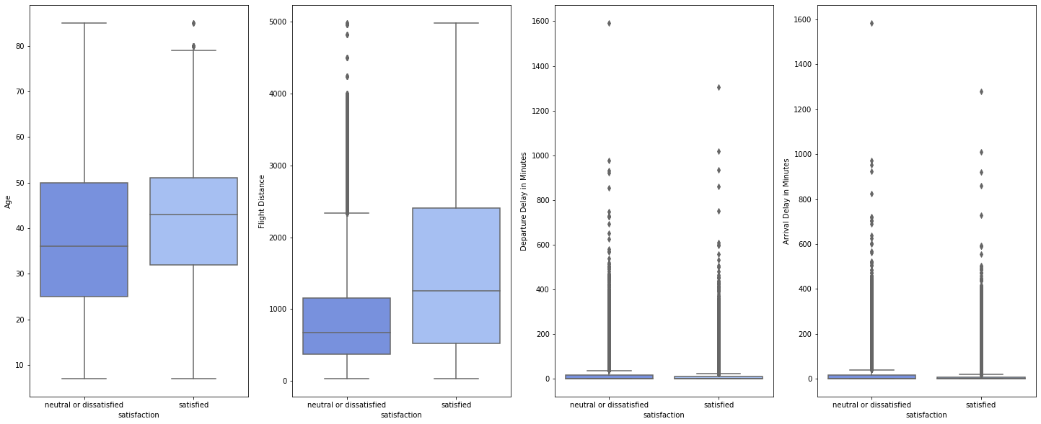
Numerical Label Distribution (Boxplot)

Slide 11
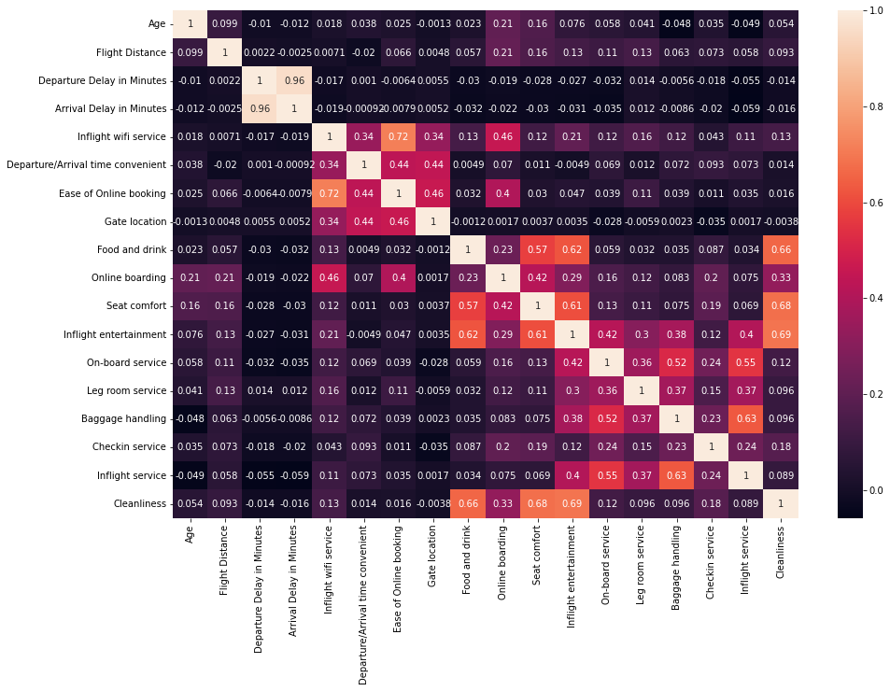
HEATMAP

Slide 12

Data Preprocessing
01
02
03
Split the data
Remove outliers
Scale the data
Using train_test_split
(train:test =4:1)
Using Interquartile Range (IQR) to detect outliers
Scale numerical data using MinMaxScaler
04A
04B
Encode Nominal Data
Encode Ordinal Data
One-Hot encode nominal columns using pandas.get_dummies
Encode ordinal columns using map

Slide 13
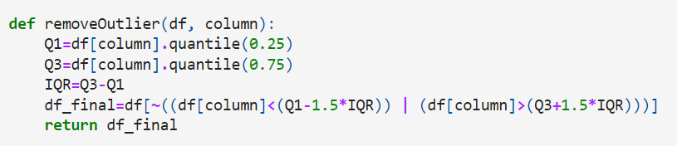
Split the Dataset
Remove Outliers

Slide 14
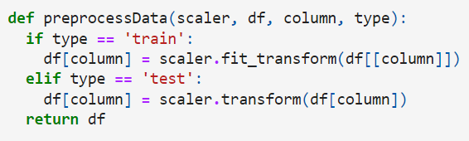
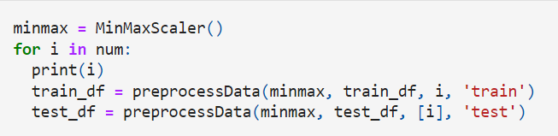
Scale Numerical Data

Slide 15
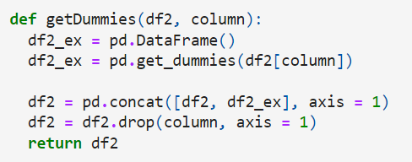



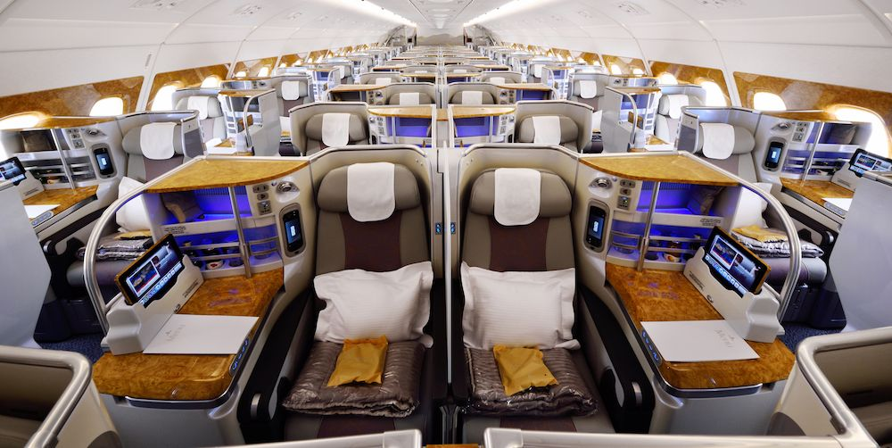

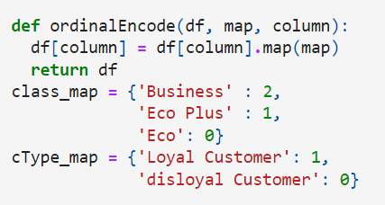
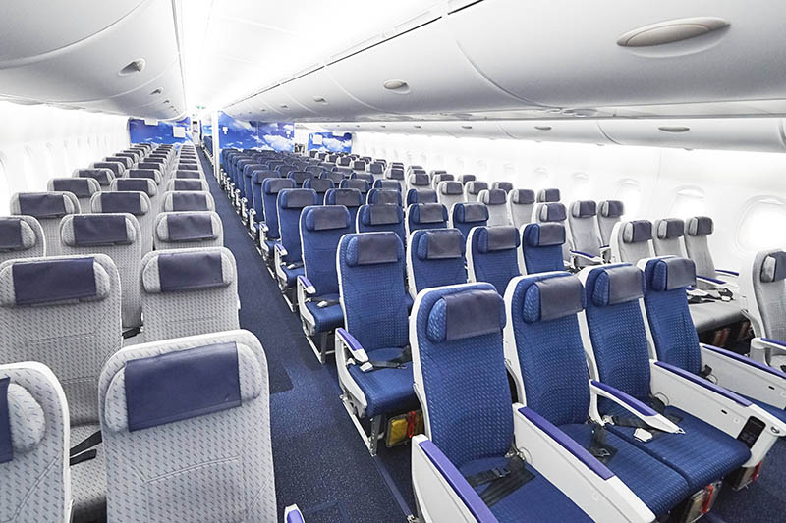
Encode Categorical Data

Slide 16
Modeling & Evaluation
Evaluation Metrics
Model redefinition
04
The metrics used are accuracy, precision, recall, F1-Score, and ROC
Fit the model with tuned parameters
Hyperparameter tuning
03
Use GridSearchCV
Filter models
02
Choose the model with best performance
Prepare models
01
Define 11 different classifier models, fit each of them and summarize it’s metrics

Slide 17
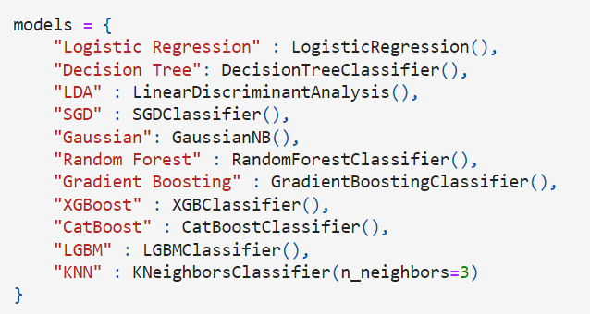
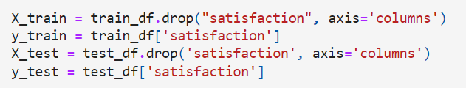
Prepare Models
First of all, we initialize the models which performances we would like to compare.
We then split the datasets into one that only contains the target column, and another that doesn’t contain the target column.

Slide 18
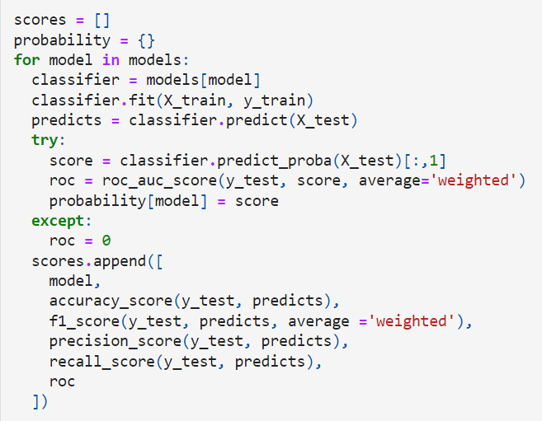
Prepare Models
We then use a loop to fit the data into each model. The scores for each model are also calculated and stored in the scores array.

Slide 19
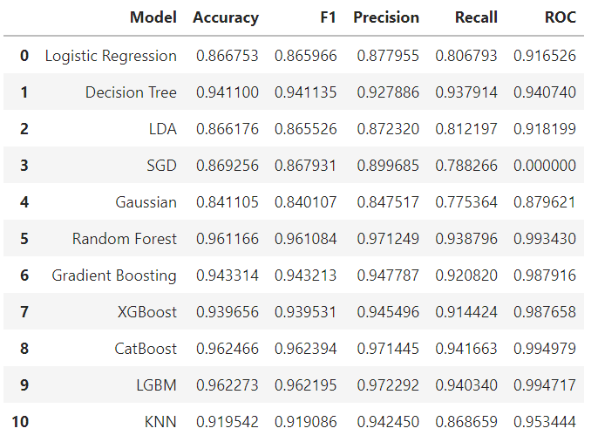
Filter Models
We then compile the scores into a dataframe, then display them for comparison purposes. Here, we saw that the CatBoost model has the highest accuracy in all of the metrics (Accuracy, F1 Score, Precision, Recall, and ROC).

Slide 20
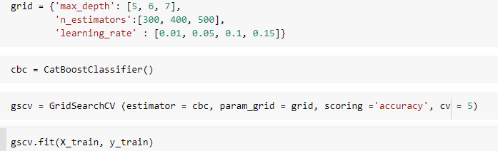
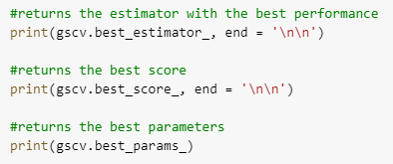
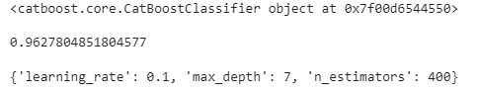
Hyperparameter Tuning
In order to improve the performance of the model, we tuned the hyperparameters using GridSearchCV.
We then output the best estimator, score, and parameters.
The resulting output can be seen below, with the best parameters being utilized in the next stage (Model Redefinition).

Slide 21
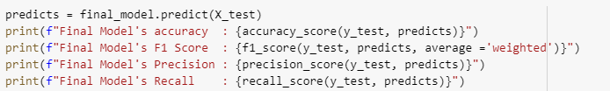
Model Redefinition
After tuning the hyperparameters, we redefine the model with the newly acquired values.
We then calculate the performance of the now redefined model using the same metrics as before (Accuracy score, F1 Score, Precision Score, and Recall Score).

Slide 22
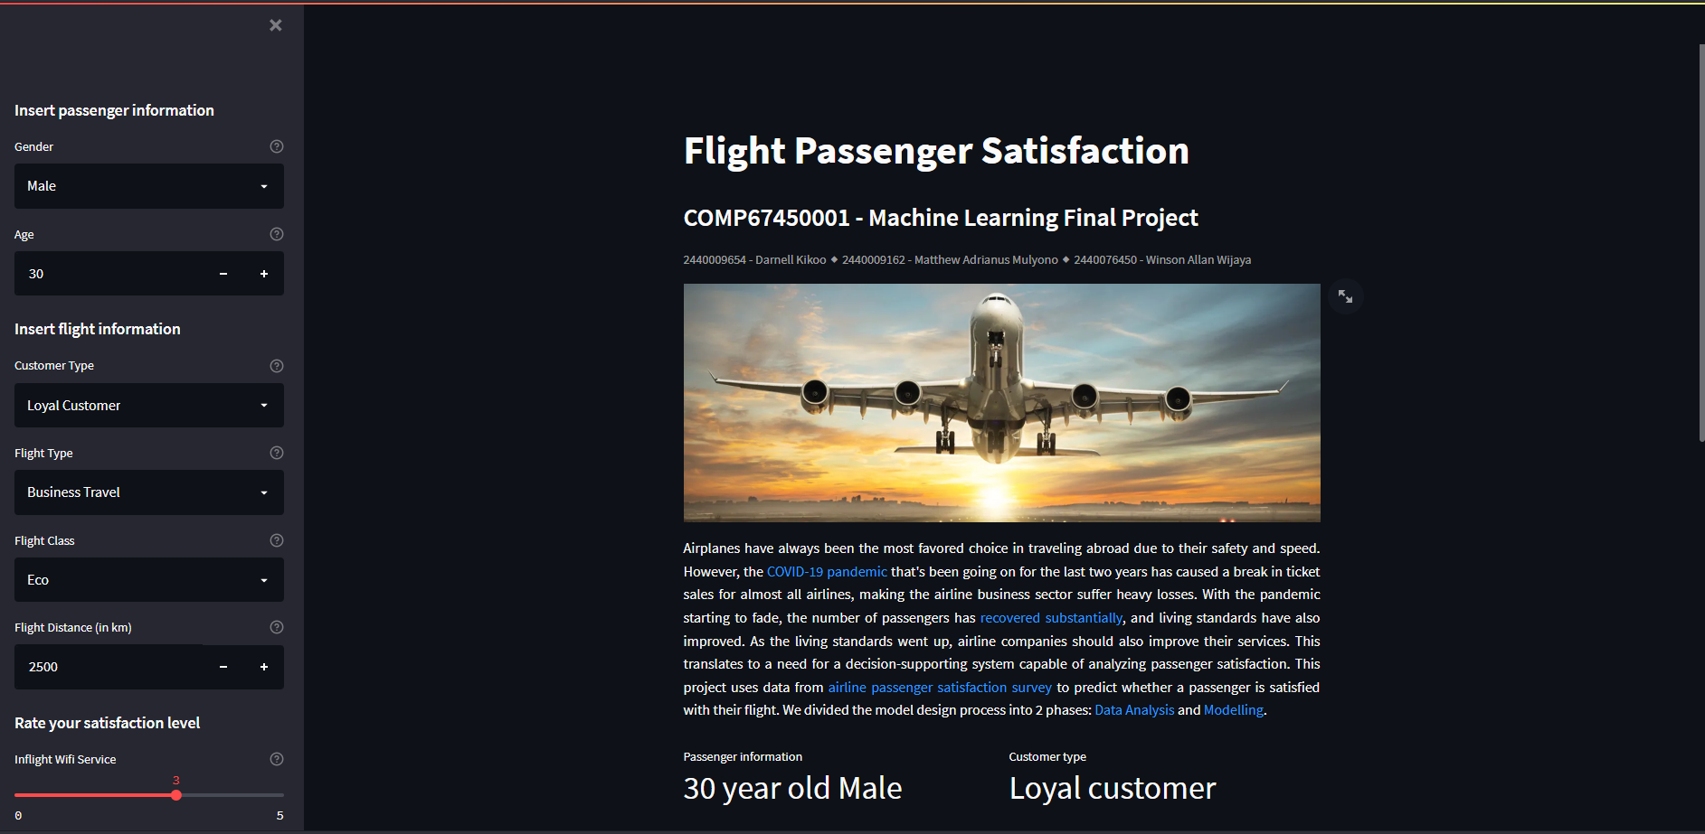
Results
Catboost Model Performance
Deployment
Metric | Performance
Accuracy | 0.9628
Precision | 0.9708
Recall | 0.9431
F1 Score | 0.9627
We deployed our model in the form of a web-application, which can be accessed through the link: https://flight-satisfaction.herokuapp.com/.
The model achieved 96.28% accuracy, supported by 97% precision, 94% recall, and 96% F1 Score.

Slide 23


